Slide 1
Foundations of Software Design
TOPIC 2
UTM-SERG Research & Consultancy Team
School of Computing
Faculty of Engineering
Universiti Teknologi Malaysia
UTM, Skudai, Johor.

Slide 2
AGENDA
Agenda 1: Motivation, Impact of Software Design
Agenda 2: Concepts and Terminology
Agenda 3: Design Principles
Agenda 4: Architectural Pattern
Agenda 5: Summary

Slide 3
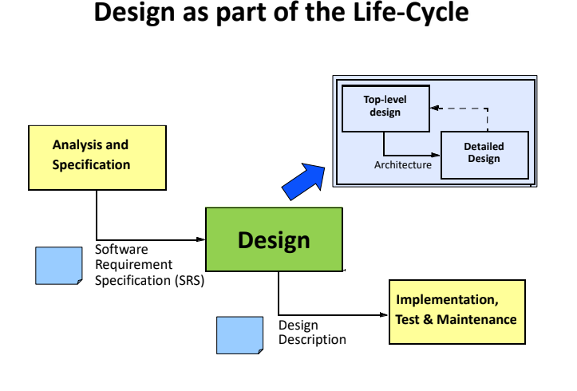
Motivation, Impact of Software Design

Slide 4
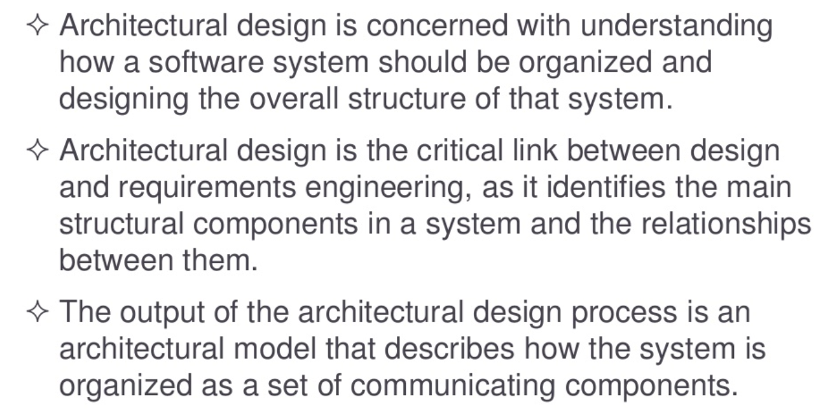
Motivation, Impact of Software Design

Slide 5
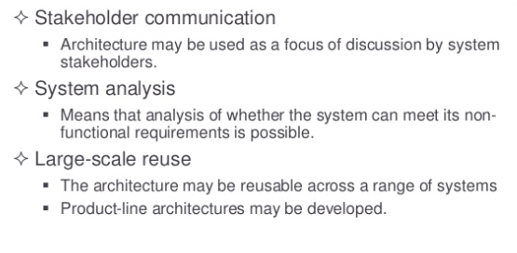
Motivation, Impact of Software Design-Advantages

Slide 6
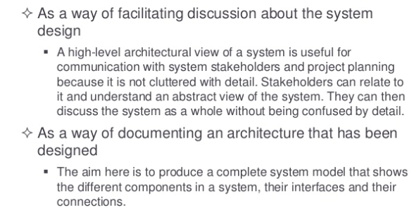
Motivation, Impact of Software Design-Use

Slide 7
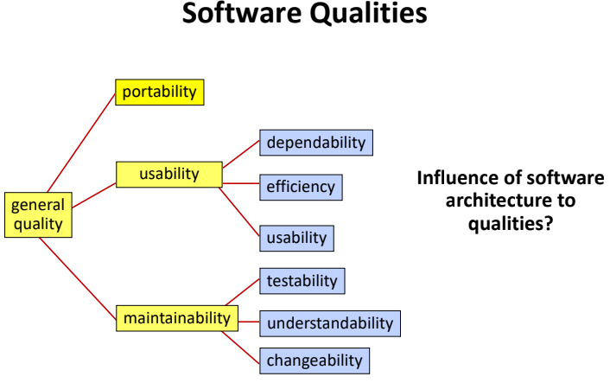
Motivation, Impact of Software Design

Slide 8
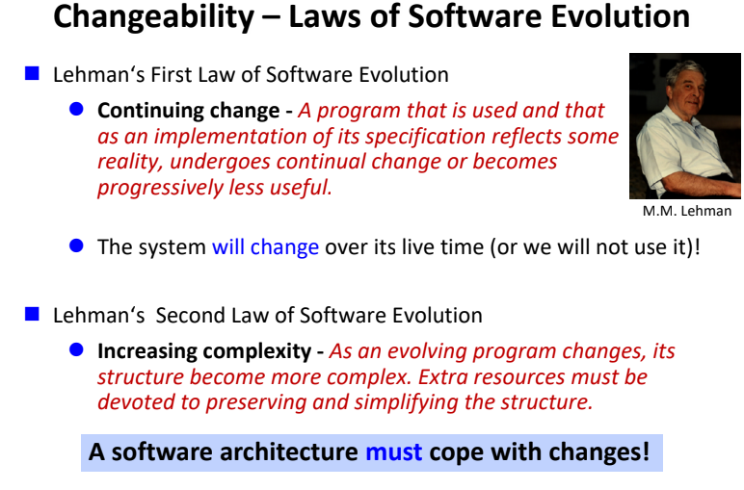
Motivation, Impact of Software Design

Slide 9
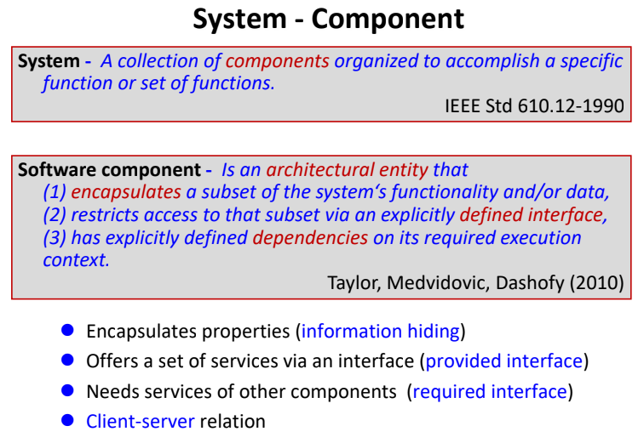
Concepts and Terminology

Slide 10
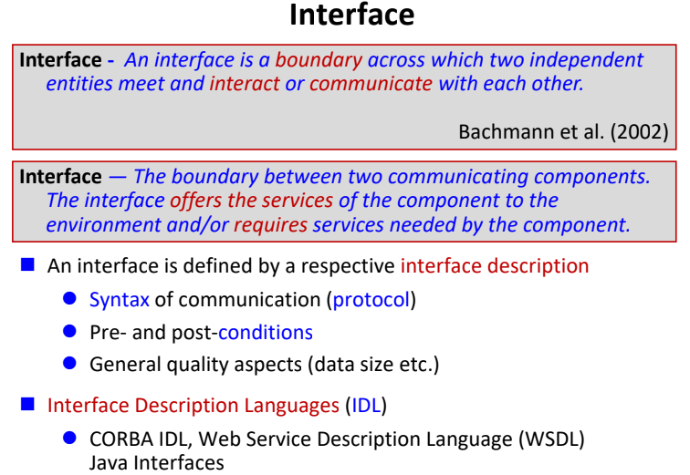
Concepts and Terminology

Slide 11
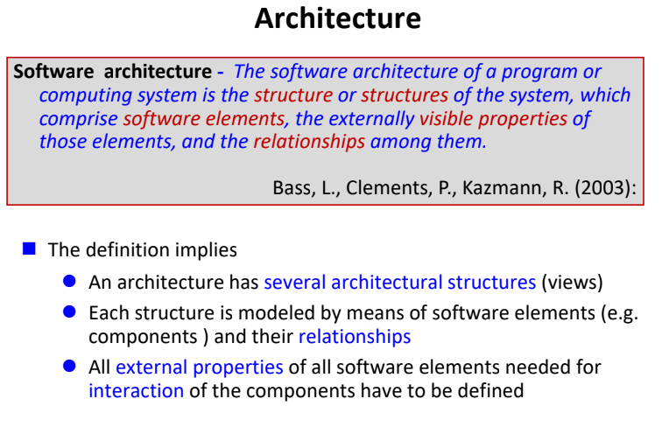
Concepts and Terminology

Slide 12
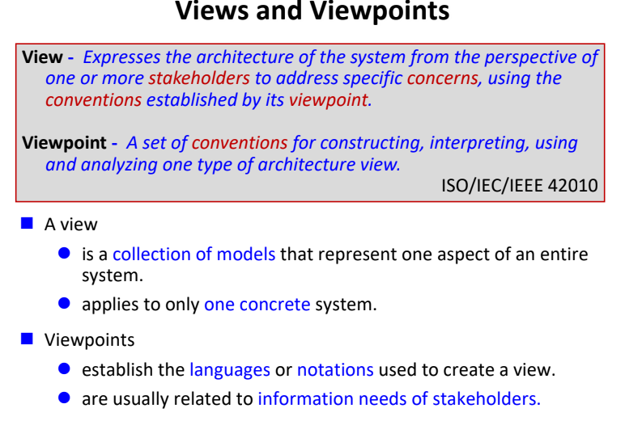
Concepts and Terminology

Slide 13
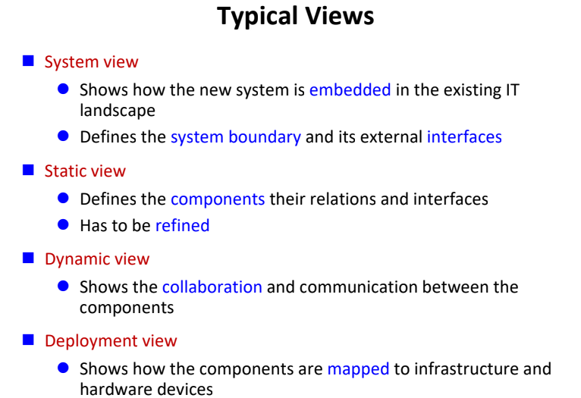
Concepts and Terminology

Slide 14
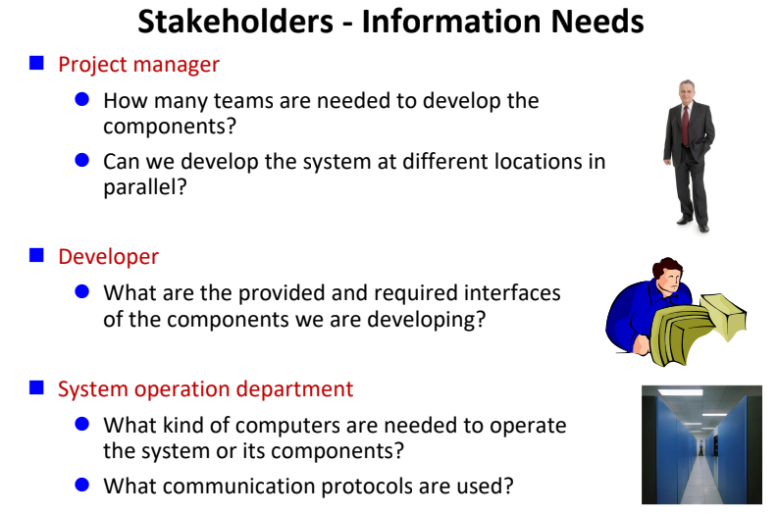
Concepts and Terminology

Slide 15
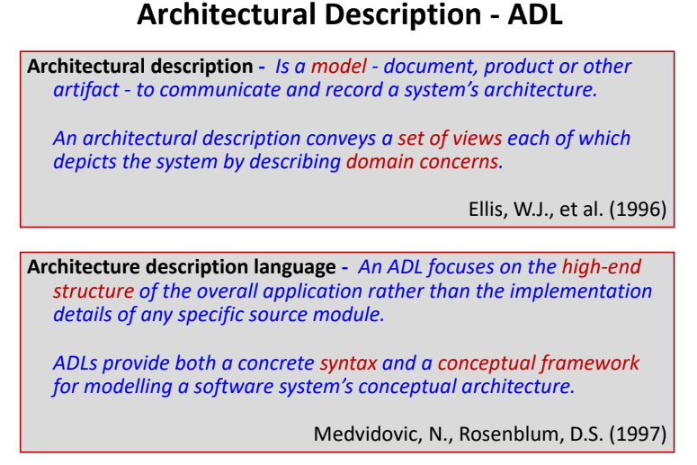
Concepts and Terminology

Slide 16
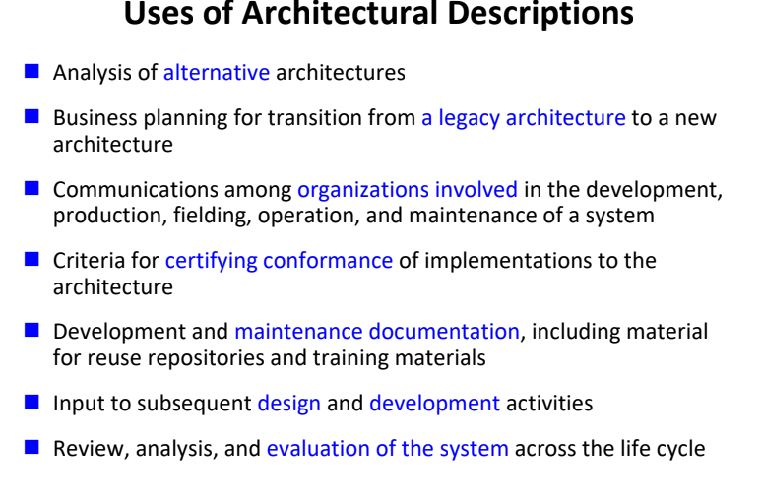
Concepts and Terminology

Slide 17
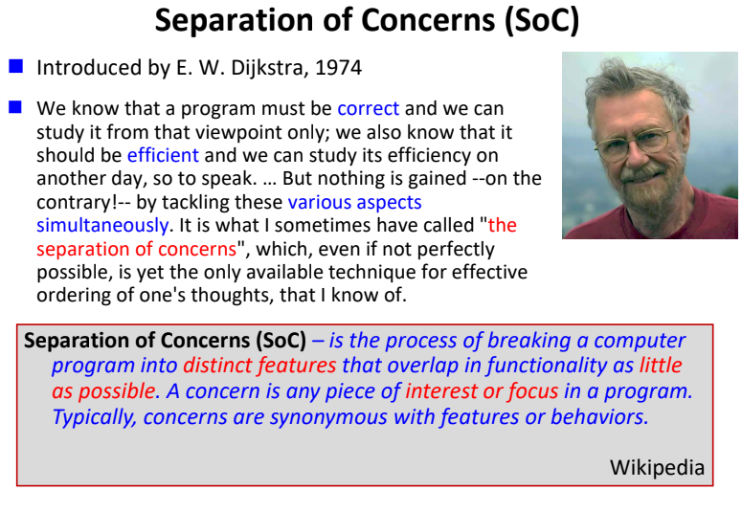
Design Principles

Slide 18
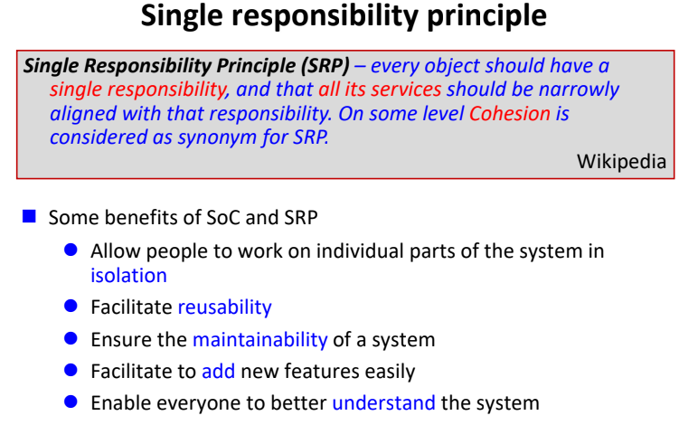
Design Principles

Slide 19
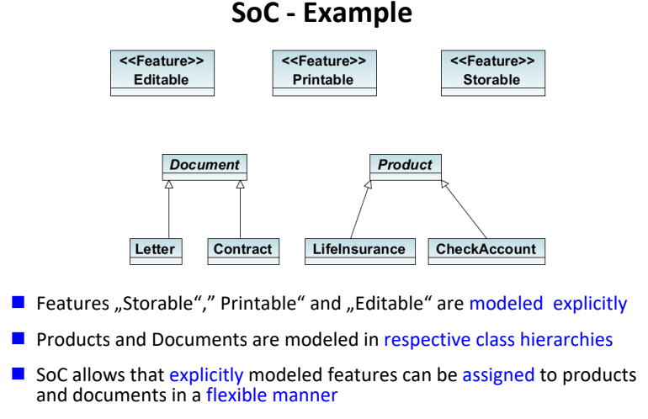
Design Principles

Slide 20
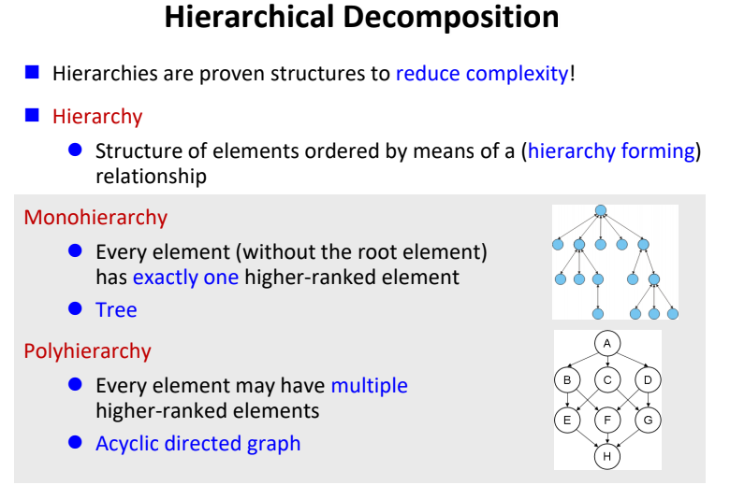
Design Principles

Slide 21
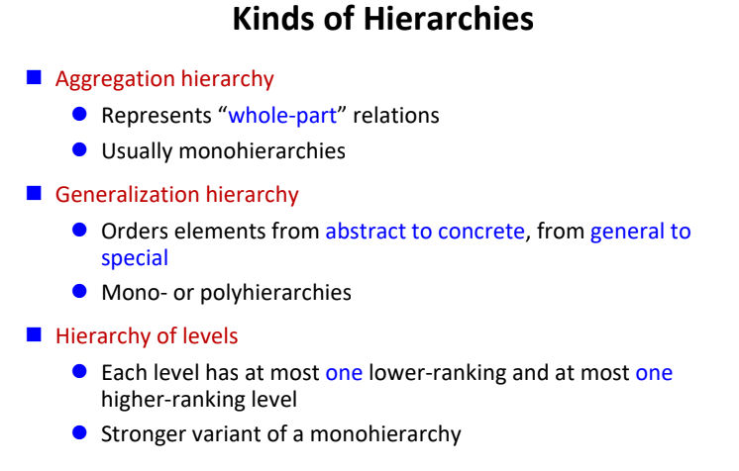
Design Principles

Slide 22
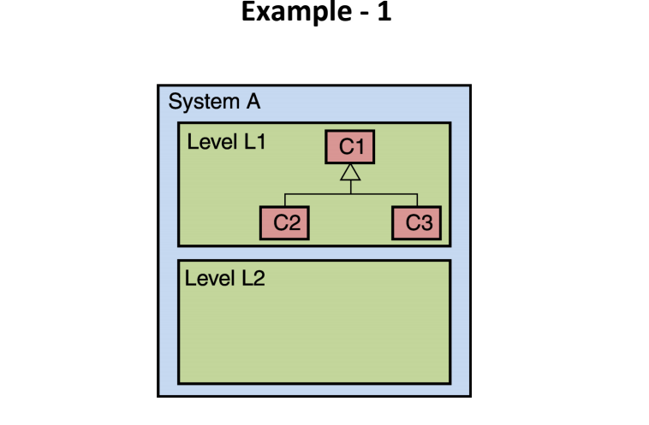
Design Principles

Slide 23
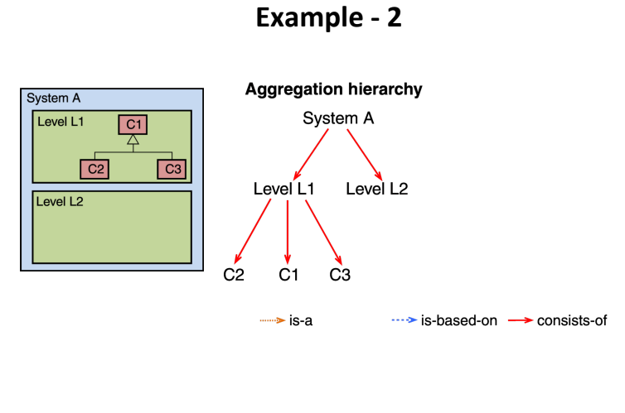
Design Principles

Slide 24
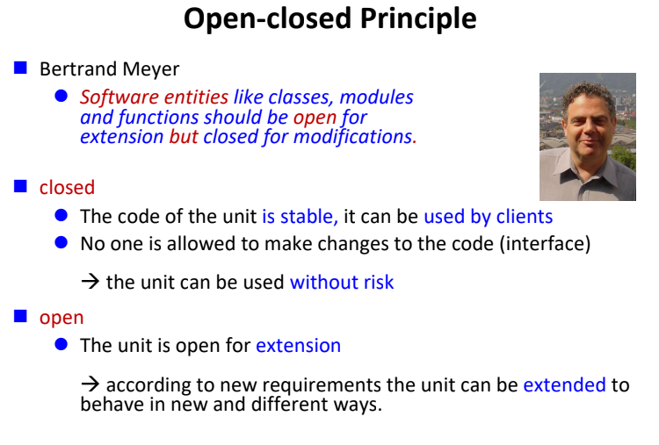
Design Principles

Slide 25
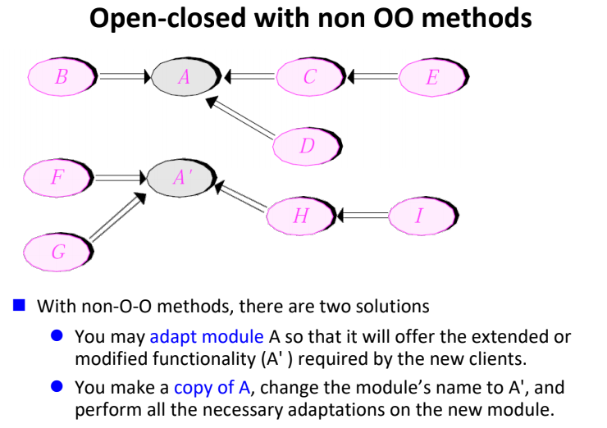
Design Principles

Slide 26
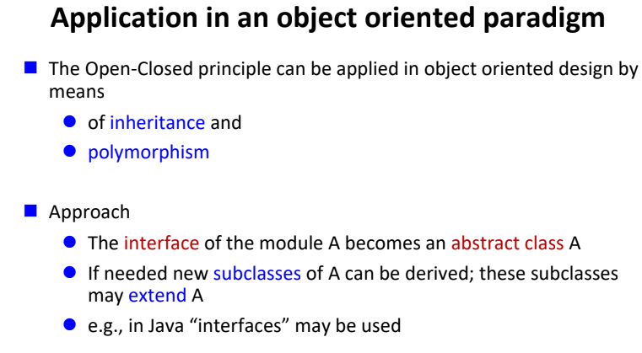
Design Principles

Slide 27
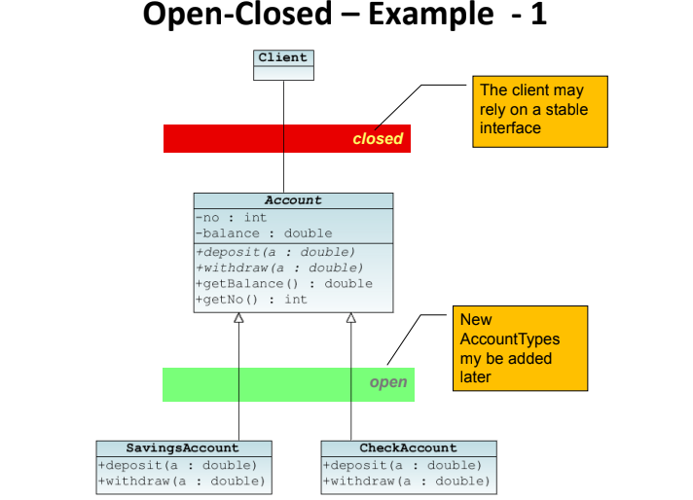
Design Principles

Slide 28
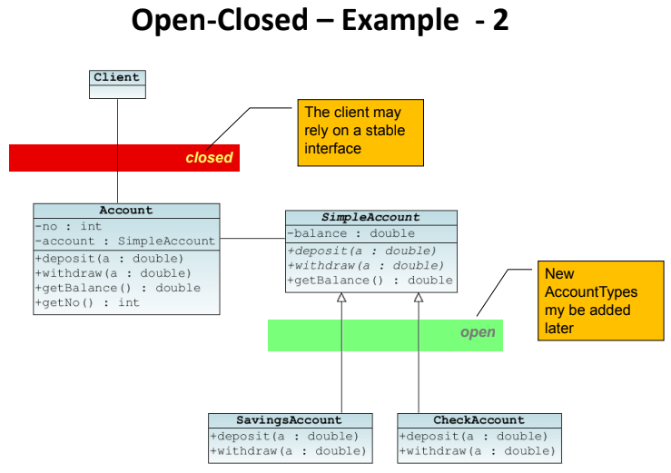
Design Principles

Slide 29
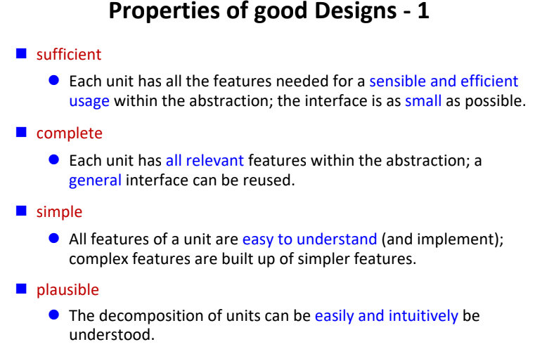
Design Principles

Slide 30
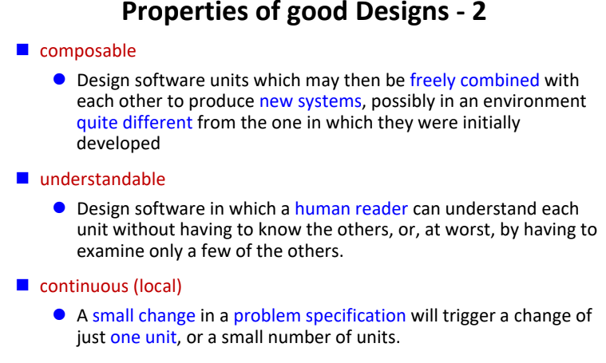
Design Principles

Slide 31
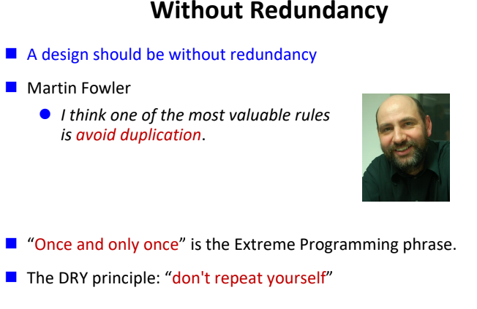
Design Principles

Slide 32
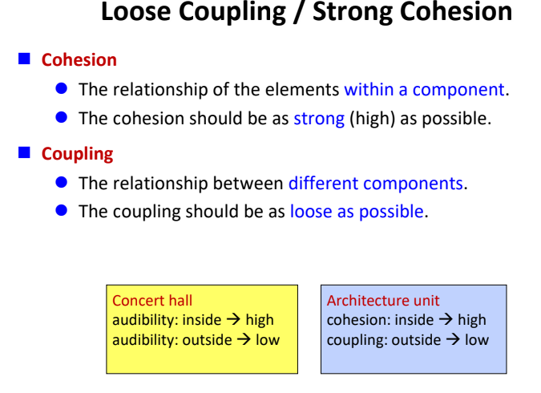
Design Principles

Slide 33
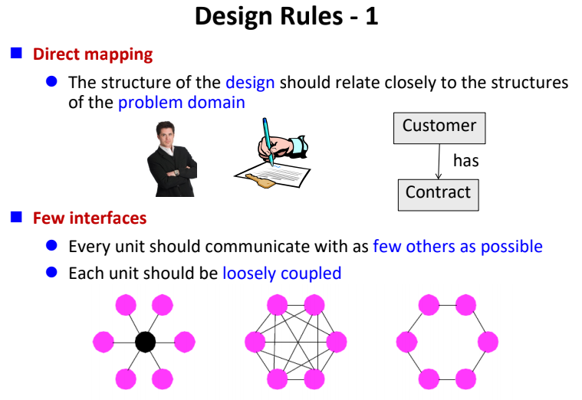
Design Principles

Slide 34
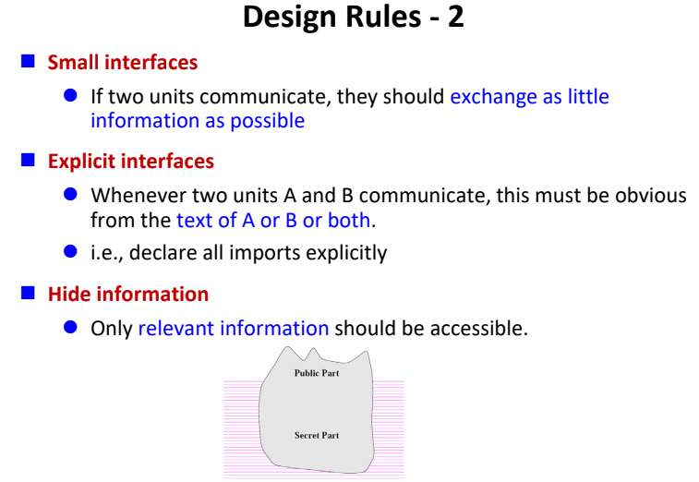
Design Principles

Slide 35
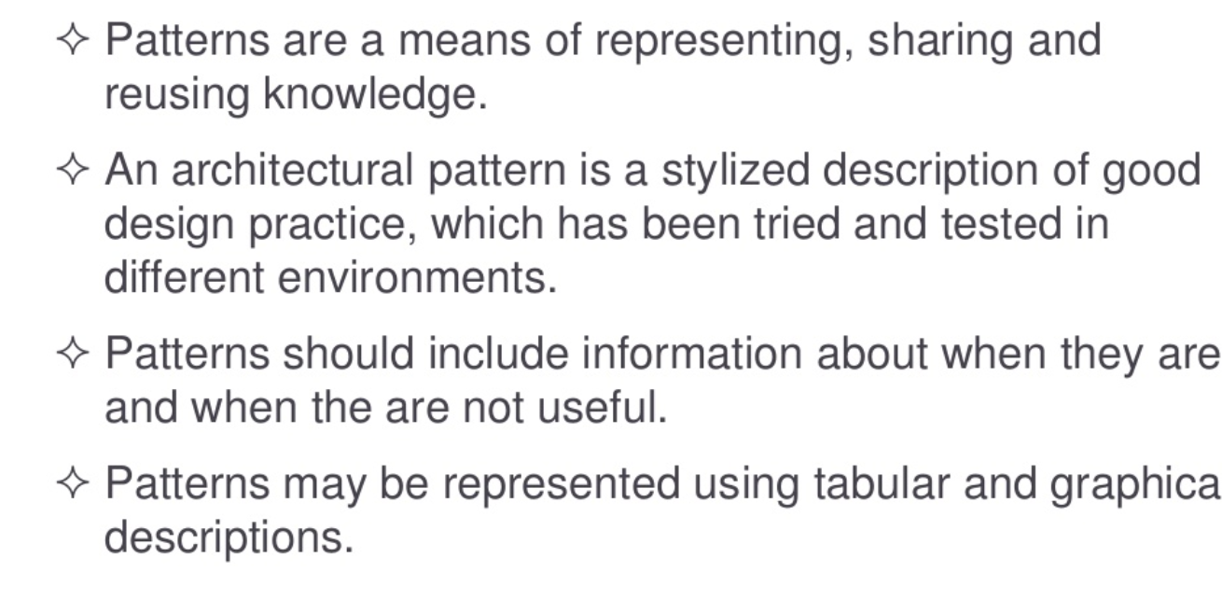
Architectural Pattern

Slide 36
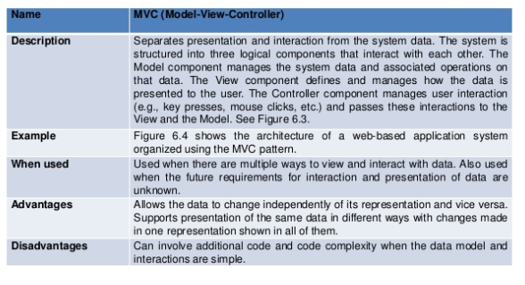
Architectural Pattern
Model View Controller

Slide 37
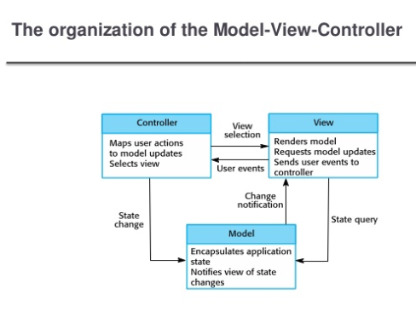
Architectural Pattern
Model View Controller

Slide 38
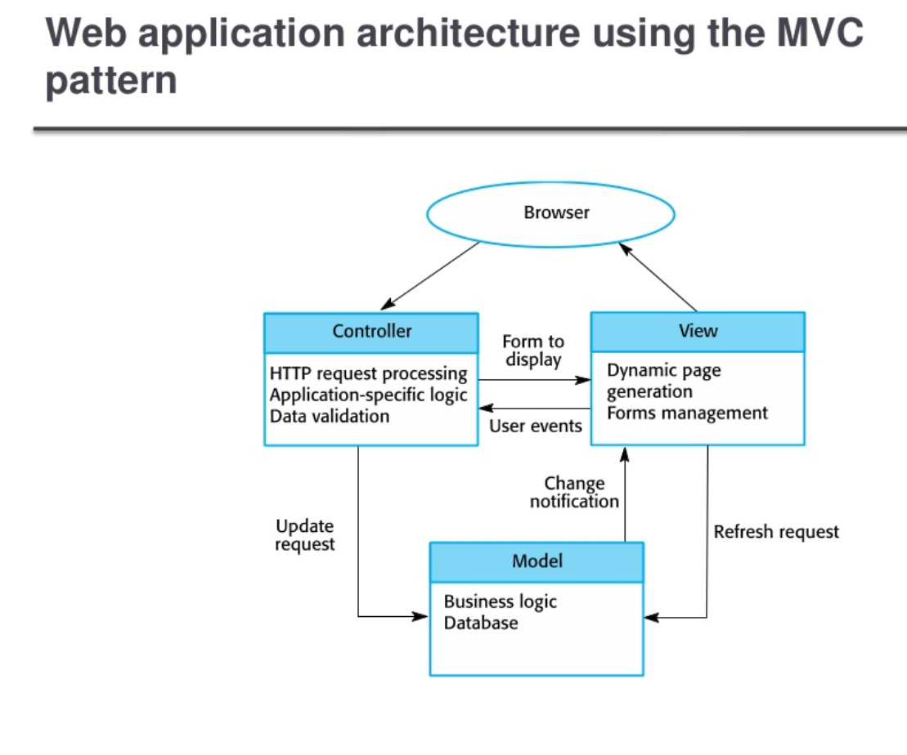
Architectural Pattern

Slide 39
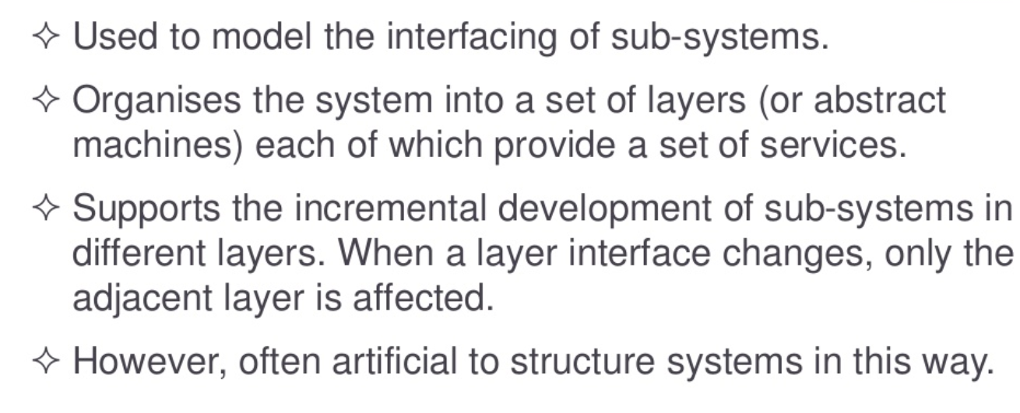
Architectural Pattern
Layered Architecture

Slide 40
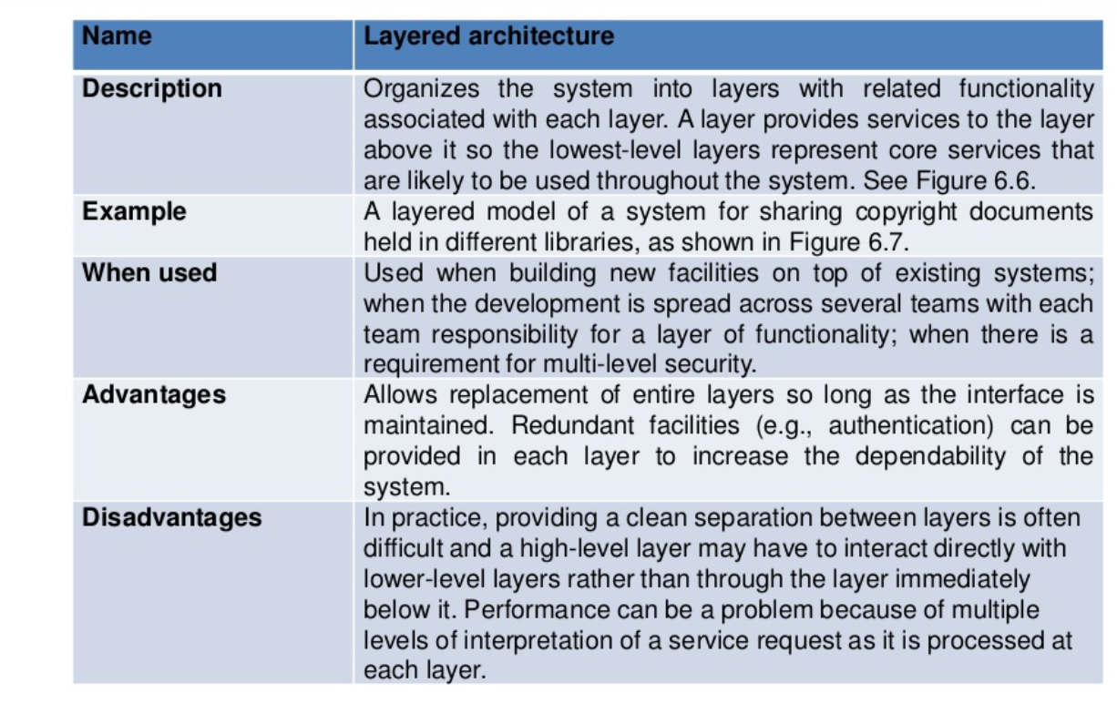
Architectural Pattern
Layered Architecture

Slide 41
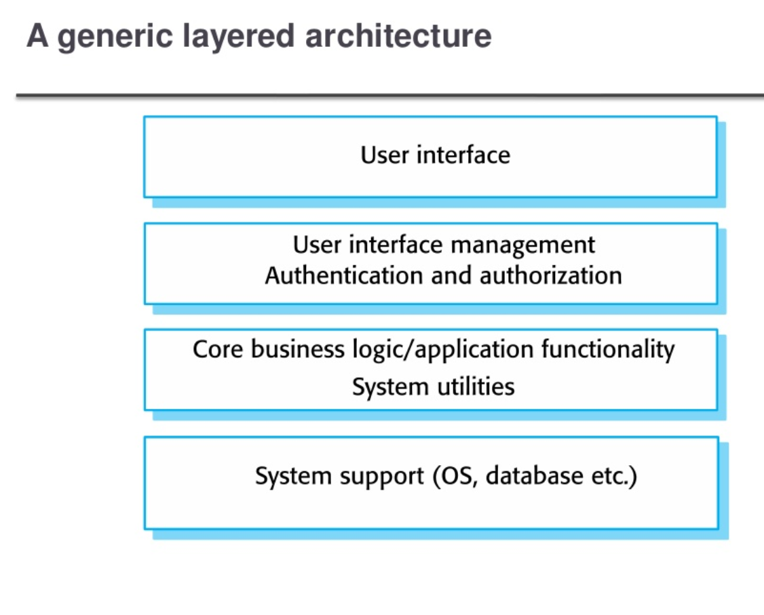
Architectural Pattern
Layered Architecture

Slide 42
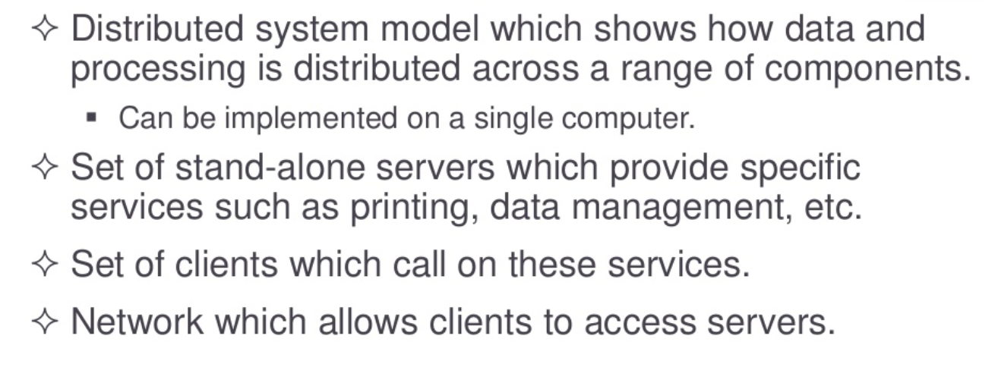
Architectural Pattern
Client Server Architecture

Slide 43
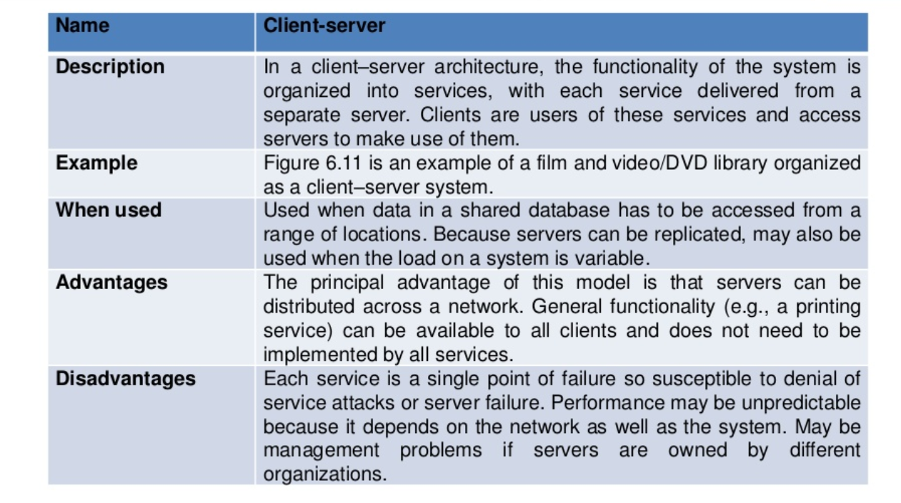
Architectural Pattern
Client Server Architecture

Slide 44
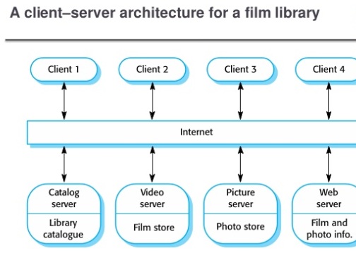
Architectural Pattern
Client Server Architecture

Slide 45
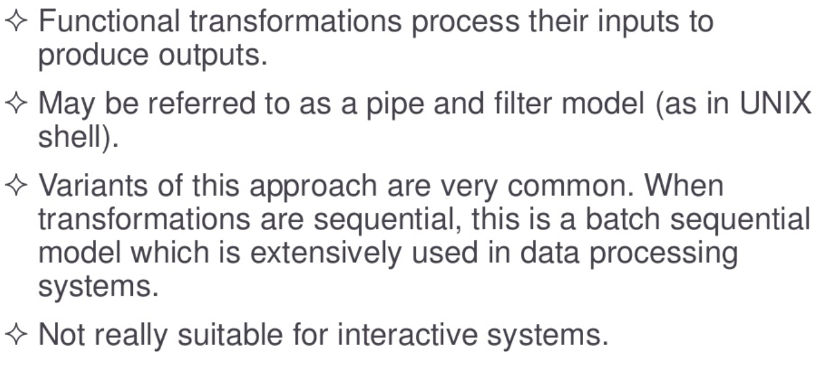
Architectural Pattern
Pipe & Filter Architecture

Slide 46
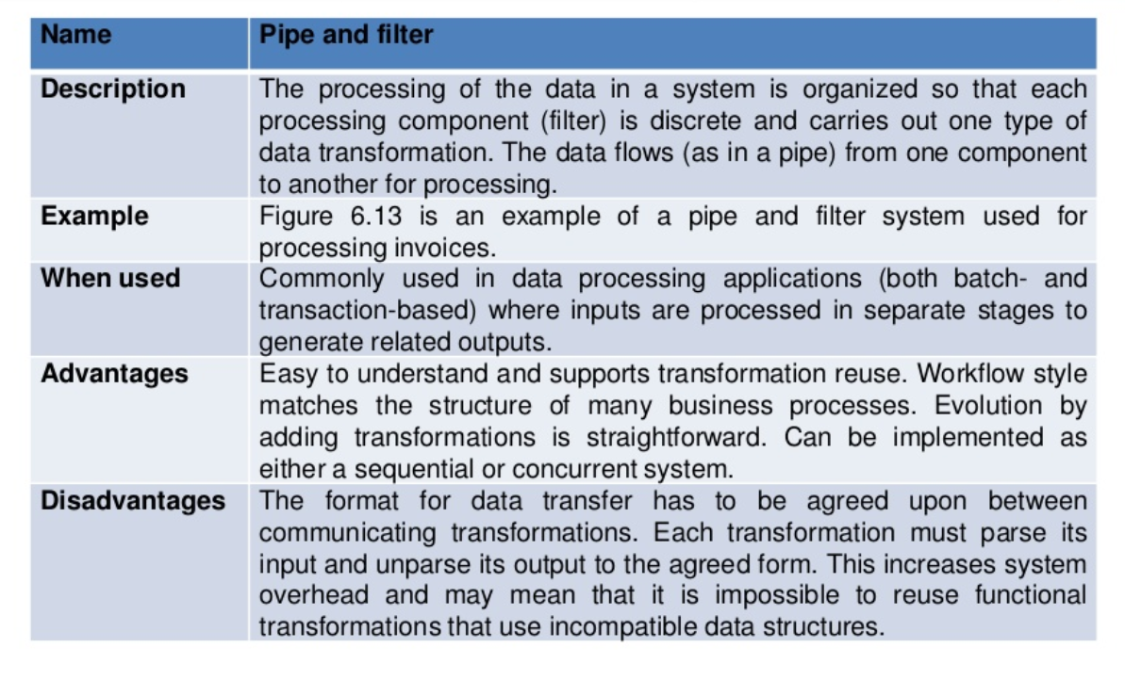
Architectural Pattern
Pipe & Filter Architecture

Slide 47
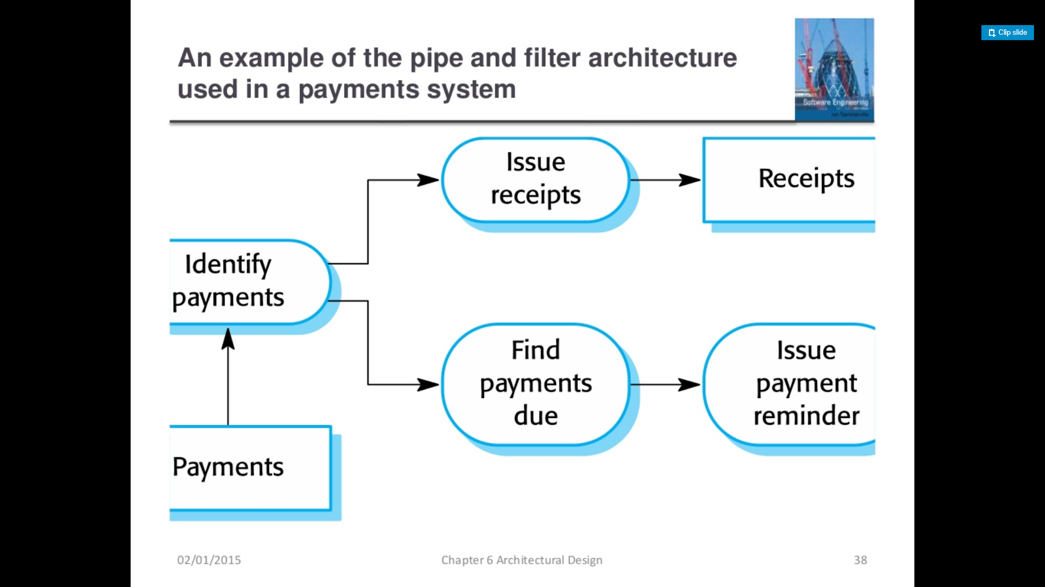
Architectural Pattern
Pipe & Filter Architecture

Slide 48
summary
An architecture is a blueprint specifying the implementation of a software system
The architecture influences central software qualities to an essential extent
Design principles and rules support architects to develop “good” architectures
A software architecture is a description of how a software system is organized.

Slide 49
Summary
Architectural design decisions include decisions on the type of application, the distribution of the system, the architectural styles to be used
Architectures may be documented from several different perspectives or views such as a conceptual view, a logical view, a process view, and a development view
Architectural patterns are a means of reusing knowledge about generic system architectures. They describe the architecture, explain when it may be used and describe its advantages and disadvantages.

Slide 50
Summary
Models of application systems architectures help us understand and compare applications, validate application system designs and assess large-scale components for reuse.
Transaction processing systems are interactive systems that allow information in a database to be remotely accessed and modified by a number of users.
Language processing systems are used to translate texts from one language into another and to carry out the instructions specified in the input language. They include a translator and an abstract machine that executes the generated language.

Slide 51
References
Ian Sommerville 2010
Horst Lichter, RWTH Aachen University

